Slide 1
BANKING
TEAM NAME : DOUGH ROLLERS

Slide 2
Problem Statement
Online banking system is specifically developed for internet banking for balance enquiry, funds transfer to another account, change of profile information and account statement. . The traditional way of maintaining details of a user in a bank was to enter the details and record them.
Every time the user needs to perform some transaction they have to go to bank and perform the necessary actions, which may not be so feasible all the time. Therefore, we provide an automation for banking system through Internet. The aim is not only automation but also a better customer experience by providing a user friendly User Interface.

Slide 3
Team Members
Vaishnav Menon (Team Leader)
Aishwarya Nair
Prerana Baad
Rutuja Nikam

Slide 4
Main Modules:
List of Main Modules of this project is :
Login Module
Admin
User
Admin Module
View And Validate Users
User Module
User registration, Add Beneficiary, Update User Details.
Transaction
Types : RTGS, NEFT and IMPS

Slide 5
Technologies and Tools
Frontend- Tools-
HTML 1. Eclipse IDE
CSS 2.Tomcat
Javascript
Backend-
Java
Spring MVC

Slide 6
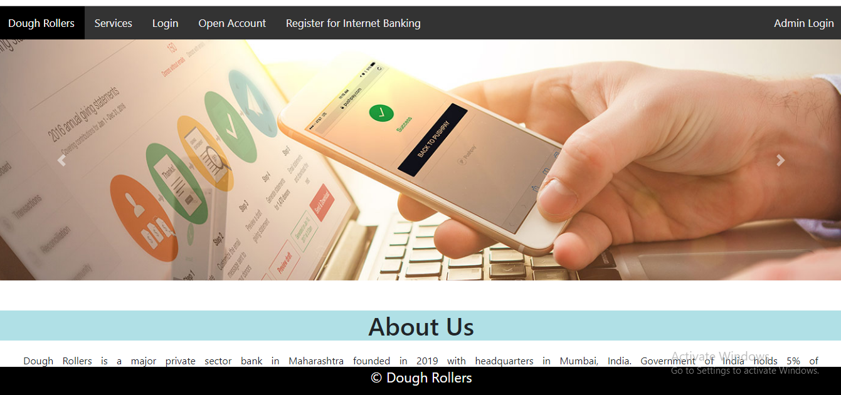
Home Page

Slide 7
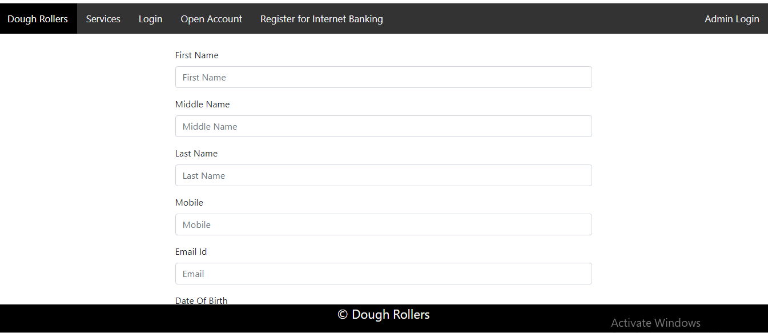
Open Account

Slide 8
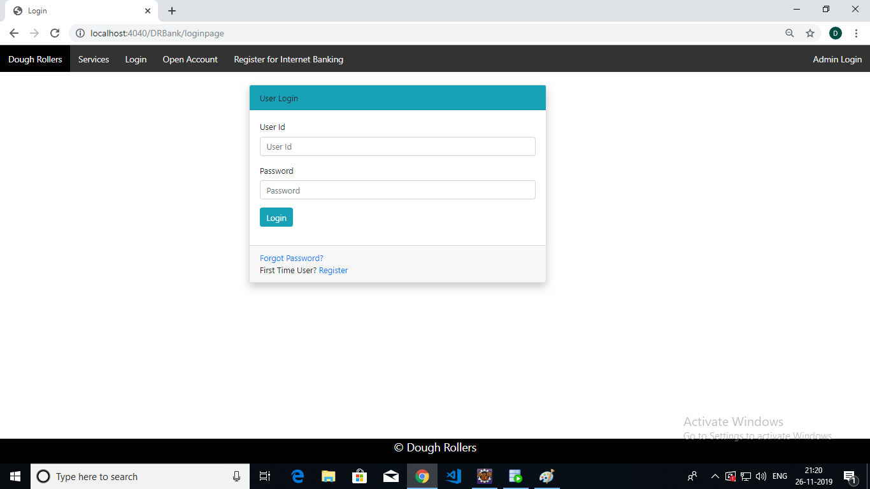
Login Page

Slide 9
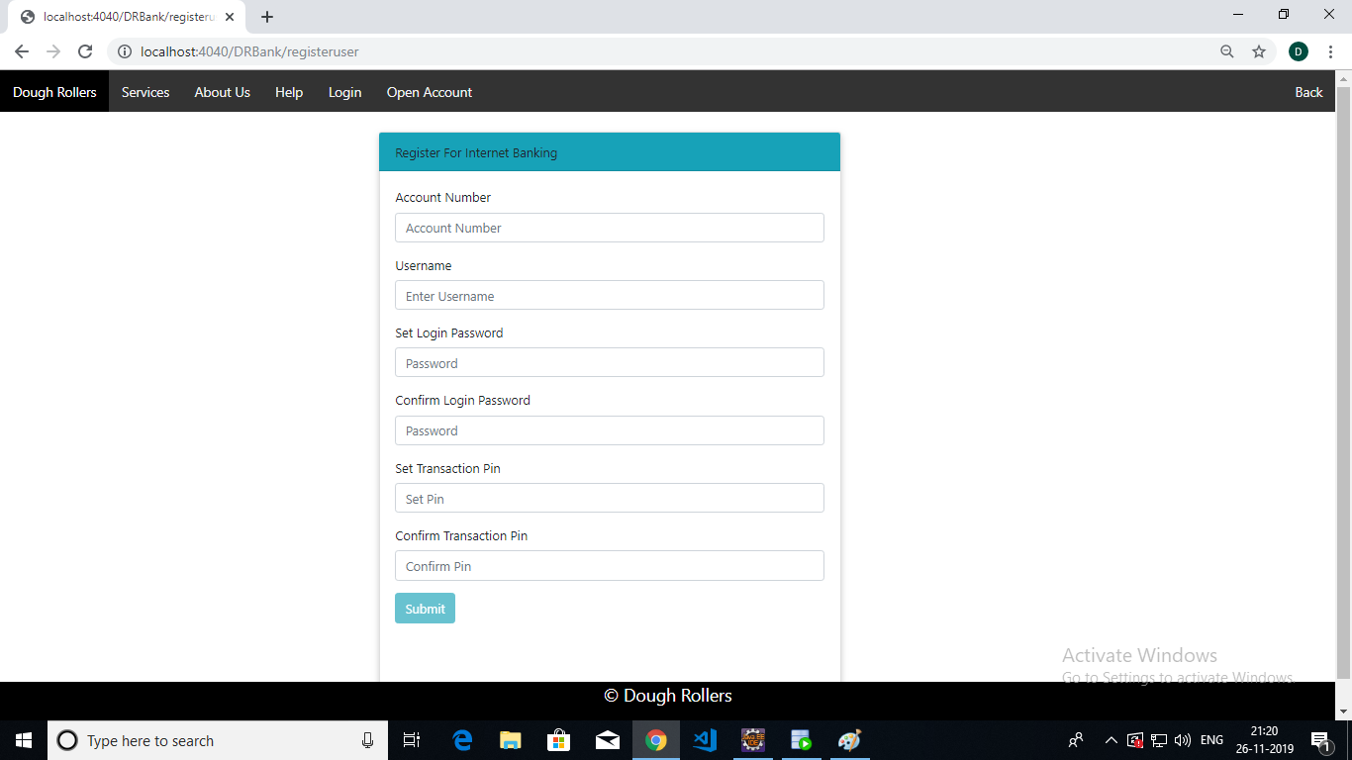
Register For Internet Banking

Slide 10
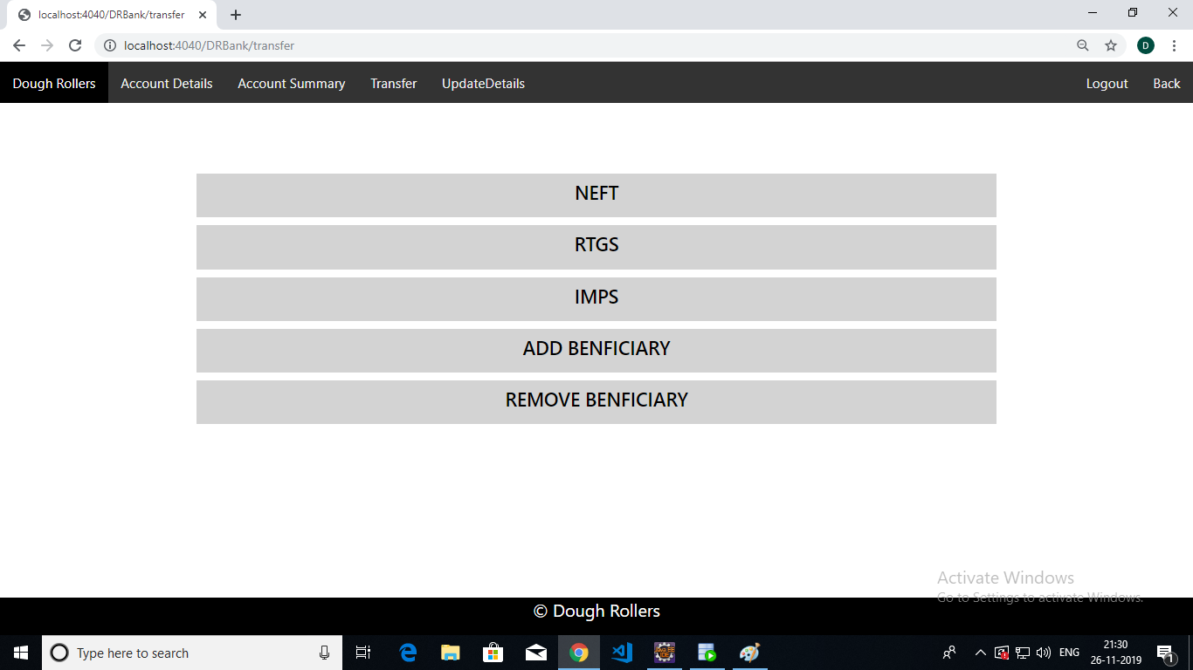
Transfer Page

Slide 11
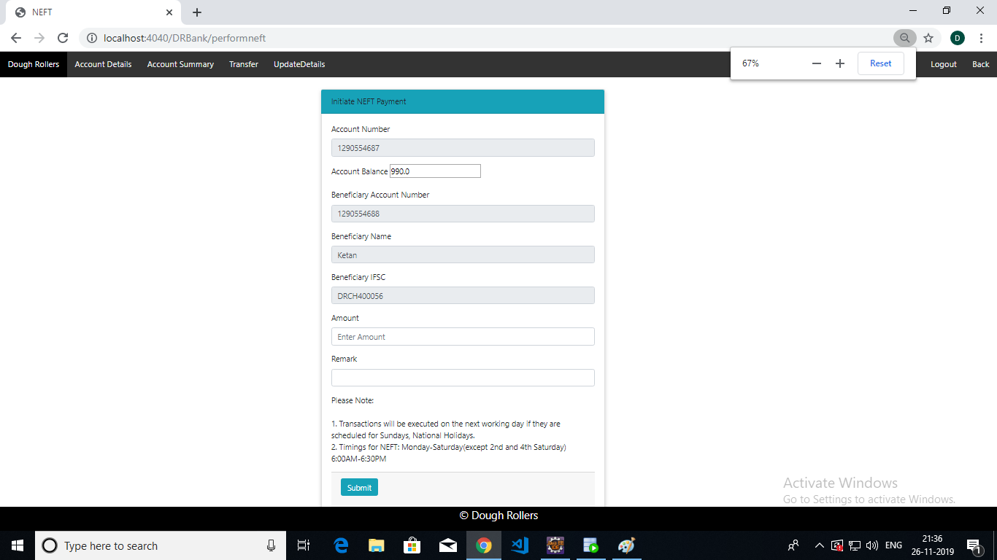
NEFT

Slide 12
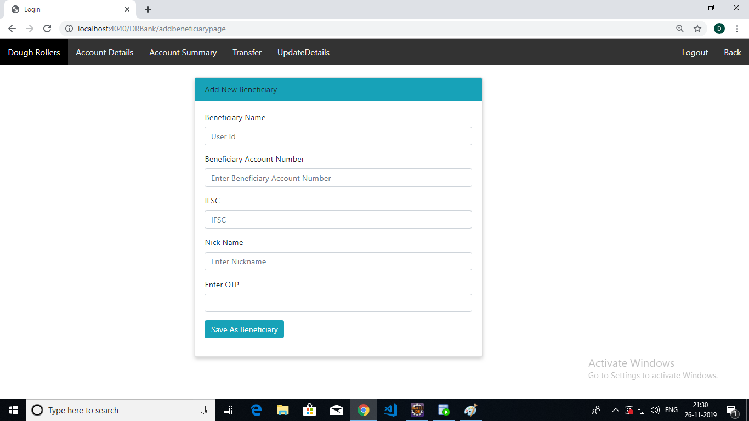
Add Beneficiary

Slide 13
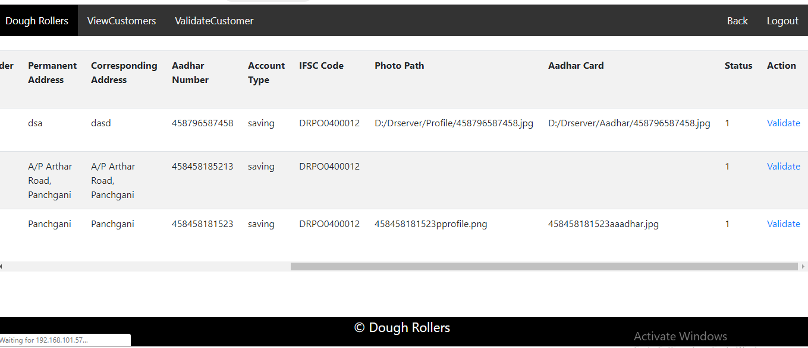
Admin Validate

Slide 14
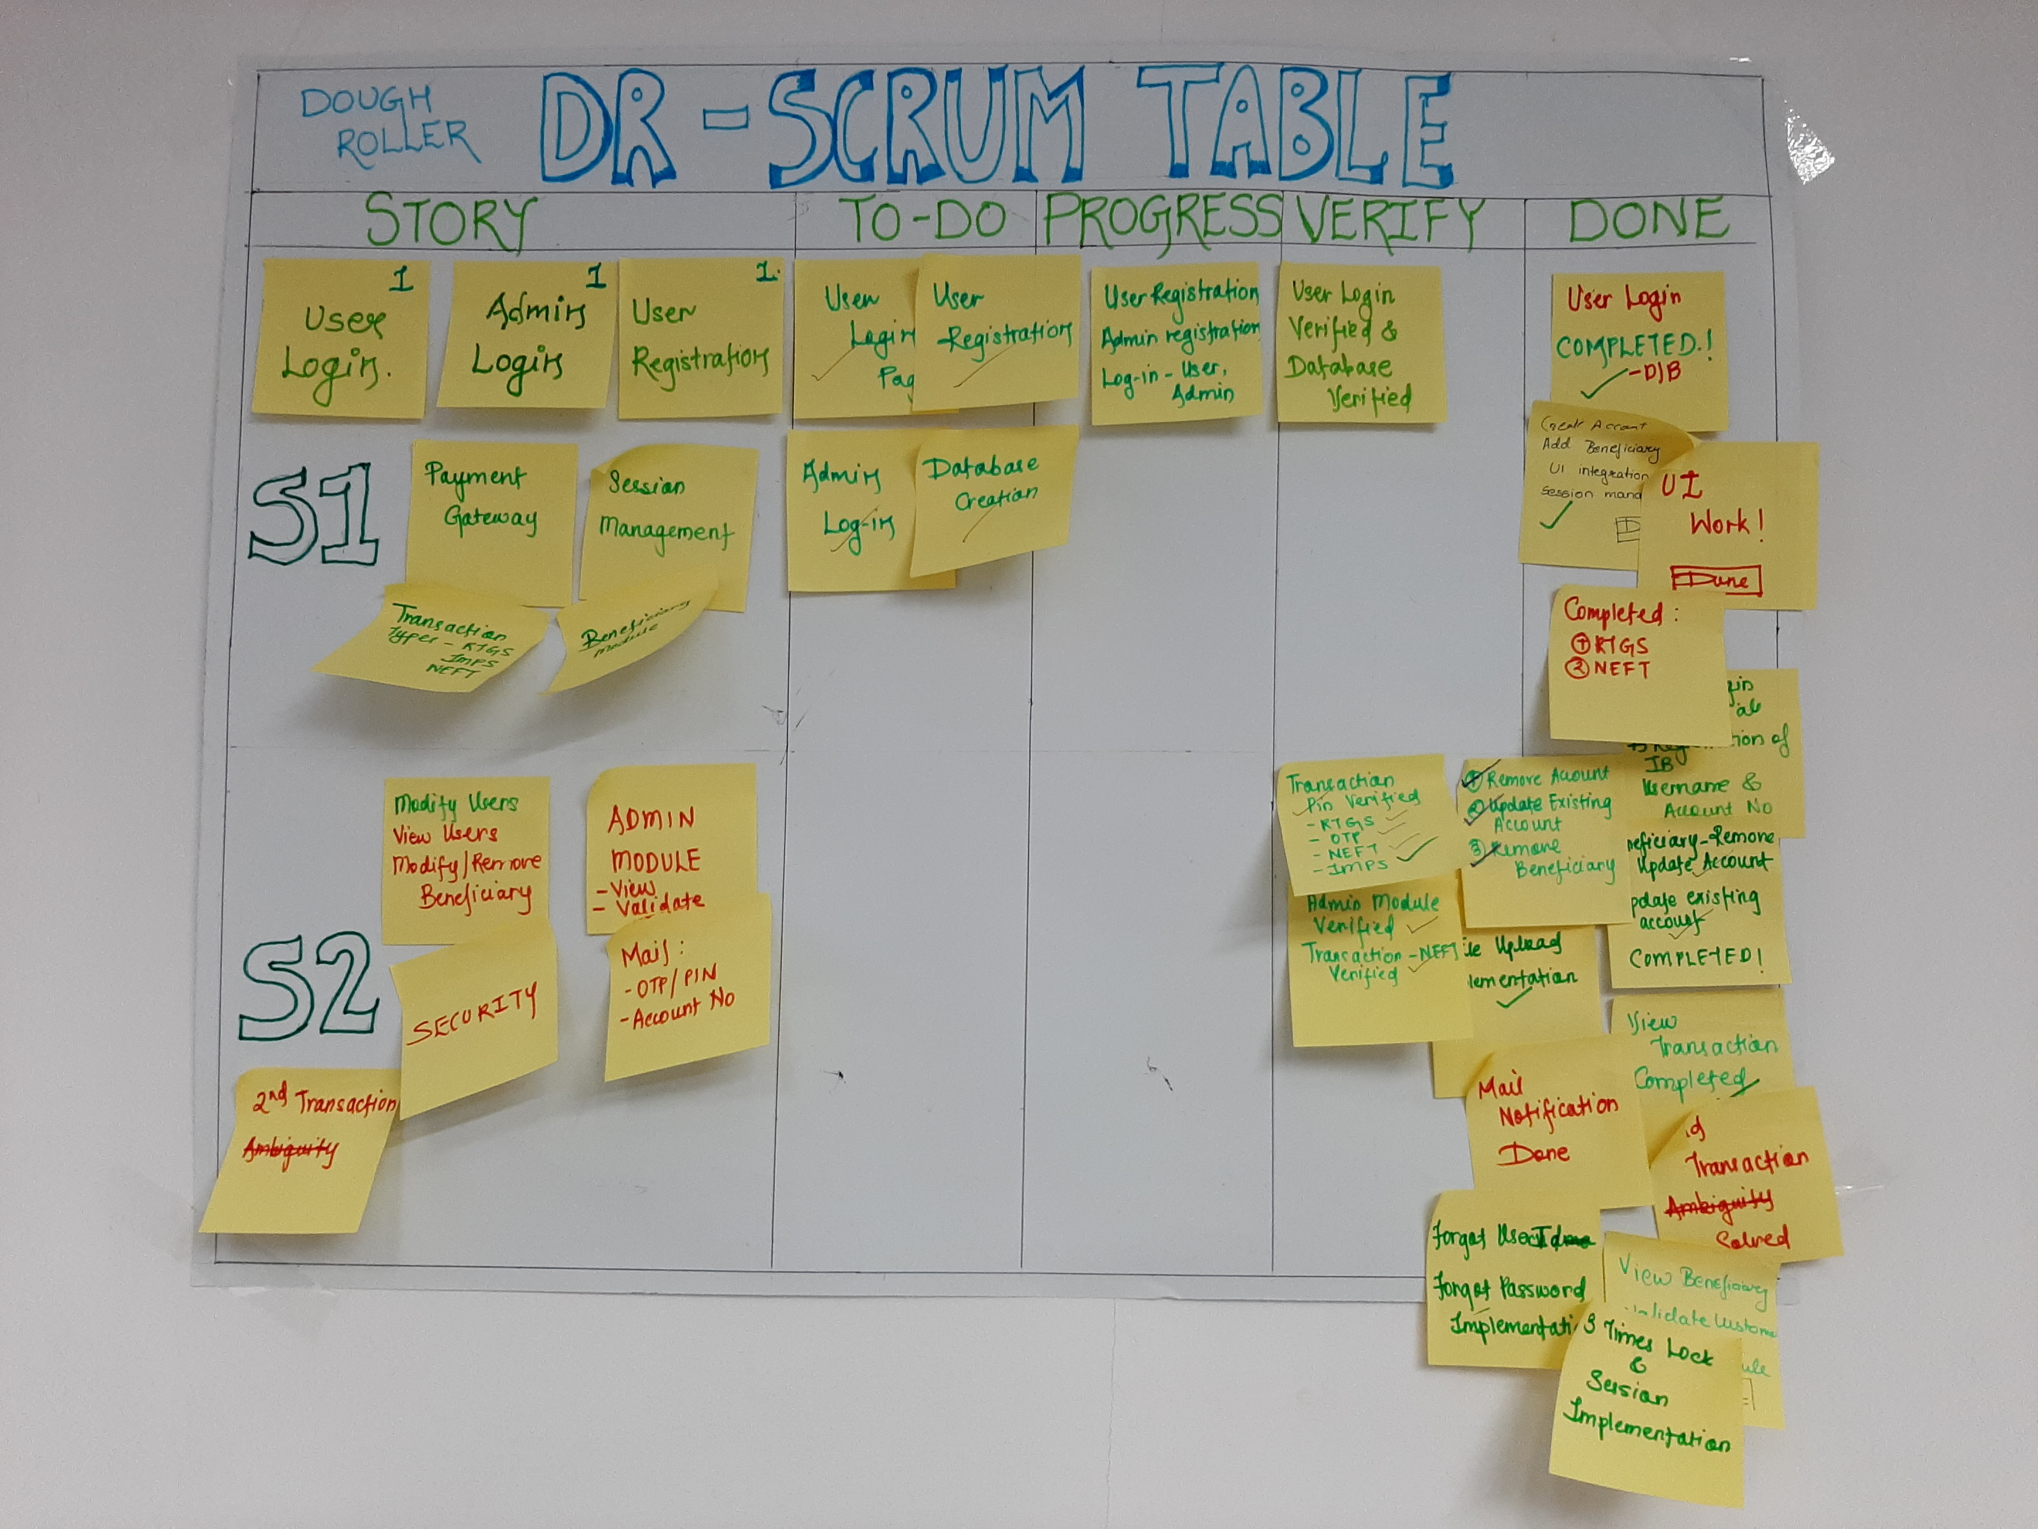
Scrum Table

Slide 15
Thank You

